Slide 1
Hotel Database Design
Transforming an entity-relationship model into a relational database diagram for efficient hotel data management.

Slide 2
Entity Relationship Model
Visual representation of entities and their relationships within the hotel database.
Rooms, Clients, Services, Reservations.
Entities
Relationships
Hotel
Rooms belong to Hotels
Room
Clients make Reservations
Client
Reservations include Services
Service
Reservation

Slide 3
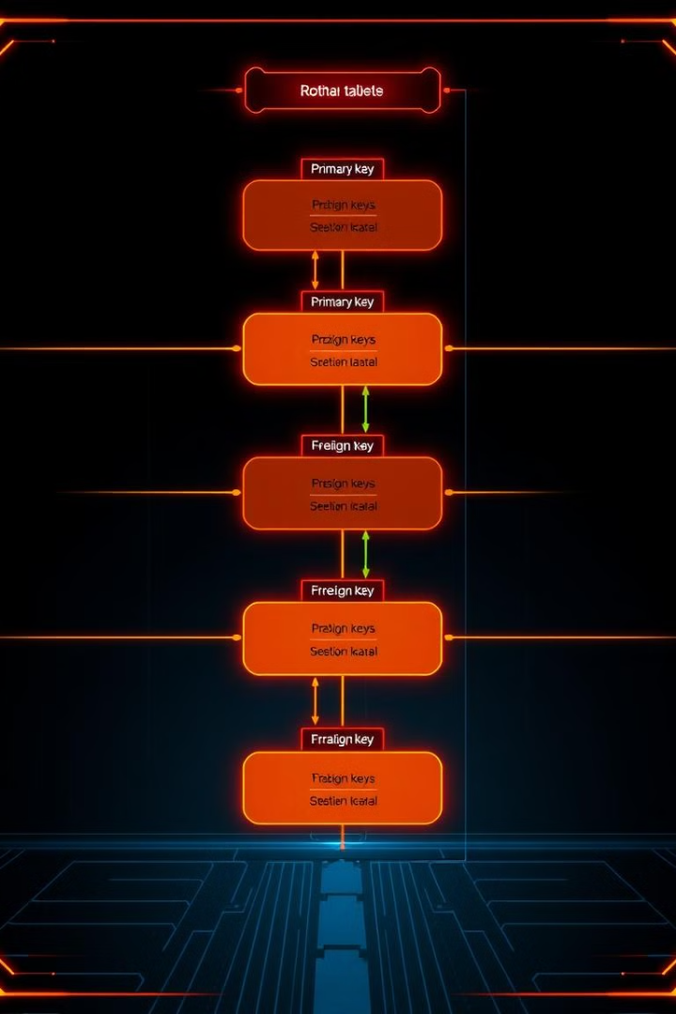
Relational Schema
Blueprint for organizing data into tables with primary and foreign keys.
Tables
Hotel (HotelID, Name, Location)
Room (RoomID, HotelID, RoomNumber, Type)
Client (ClientID, Name, Address)
Service (ServiceID, Name, Price)
Reservation (ReservationID, ClientID, RoomID, Date, ServiceID)

Slide 4

Hotel Table
Stores information about each hotel, such as ID, name, and location.
Column
Data Type
Constraints
HotelID
INT
PRIMARY KEY
Name
VARCHAR(255)
NOT NULL
Location
VARCHAR(255)
NOT NULL

Slide 5

Room Table
Details about each room, including ID, hotel, number, and type.
Column
Data Type
Constraints
RoomID
INT
PRIMARY KEY
HotelID
INT
FOREIGN KEY referencing Hotel(HotelID)
RoomNumber
VARCHAR(255)
NOT NULL
Type
VARCHAR(255)
NOT NULL

Slide 6
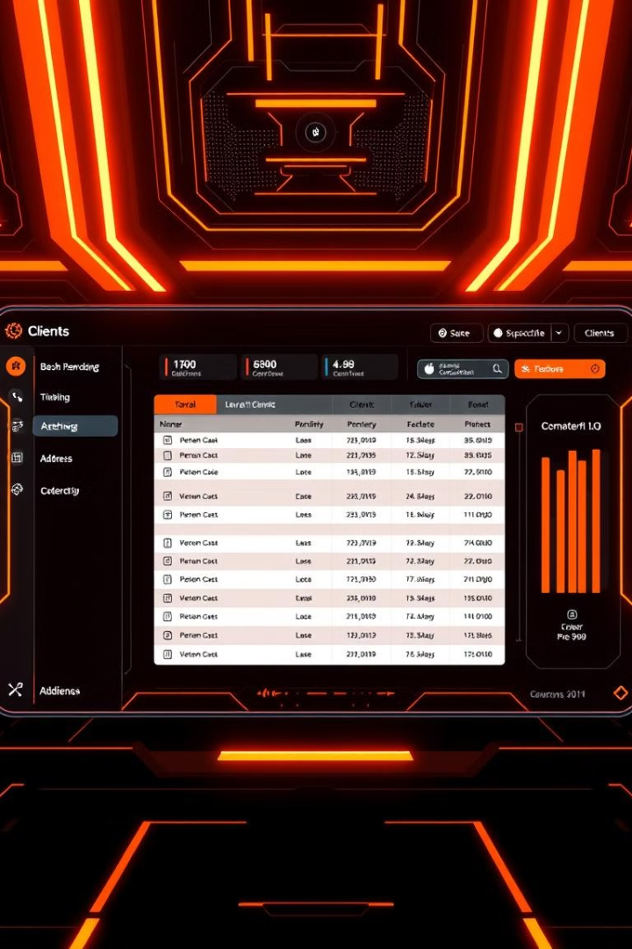
Client Table
Information about clients, like ID, name, and address.
Column
Data Type
Constraints
ClientID
INT
PRIMARY KEY
Name
VARCHAR(255)
NOT NULL
Address
VARCHAR(255)
NOT NULL

Slide 7
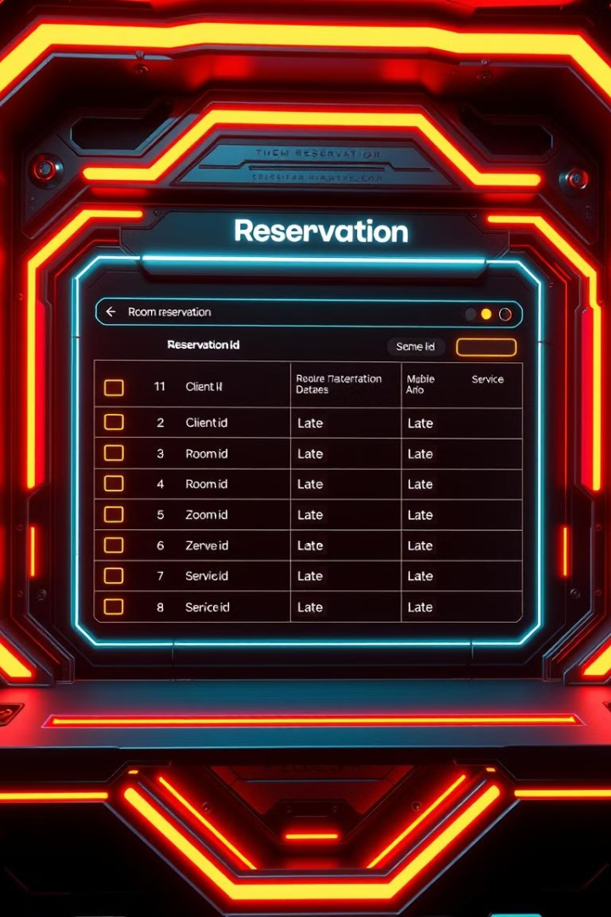
Reservation Table
Records of reservations, including client, room, date, and services.
Column
Data Type
Constraints
ReservationID
INT
PRIMARY KEY
ClientID
INT
FOREIGN KEY referencing Client(ClientID)
RoomID
INT
FOREIGN KEY referencing Room(RoomID)
Date
DATE
NOT NULL
ServiceID
INT
FOREIGN KEY referencing Service(ServiceID)

Slide 8

Key Takeaways
1
Efficient Data Management
2
Data Integrity
Primary and foreign keys ensure consistency.
Organized database structure for streamlined operations.
3
Scalability
Relational model supports future growth.

